Slide 1
Public Finance
Lecture-5
Public Choice Theory
Tahmina Akter ( tahmina.akter@bubt.edu.bd )
Assistant Professor, Economics, BUBT
References: Browning chapter 3, Rosen chapter 6, Stiglitz chapter 9

Slide 2
Public Choice B
The theory of public choice is the study of how governmental decisions are made and implemented; as such, it essentially involves an analysis of the political process.
Public choice theory tries to explain what government actually does (or will do in certain circumstances), as distinct from an attempt to prescribe what government should do.
This approach is based on the premise that individuals attempt to further their own interests in their political activities, just as in their economic activities.

Slide 3
Voting and Resource Allocation
Unanimity rules
Direct majority voting
Median voter theorem
Logrolling

Slide 4
Unanimity Rules R
The free rider problem can lead to a disturbing situation— because people are selfish, public goods are underprovided, even though everyone could be made better off if they were provided in efficient amounts. This suggests that, in principle, if a vote were taken on whether to provide an efficient quantity of the good, consent would be unanimous as long as there was a suitable tax system to finance it. A procedure designed to elicit unanimous agreement was proposed in the early 20th century by Erik Lindahl.

Slide 5
Direct Majority Voting R
In any pairwise elections level B wins.
Suppose an election were held on whether to adopt A or B. Brad would vote for A, while Jen and Angelina would vote for B. Hence, B would win by a vote of 2 to 1. Similarly, if an election were held between B and C, B would win by a vote of 2 to 1. Level B wins any election against its opposition, and thus is the option selected by majority rule. Note that the selection of B is independent of the order in which the votes are taken.
Rank | Brad | Jen | Angelina
First | A | C | B
Second | B | B | C
Third | C | A | A

Slide 6
Contd.
Majority decision rules do not always yield such clear-cut results. Again, imagine a series of paired elections to determine the most preferred level. In an election between A and B, A would win by a vote of 2 to 1. If an election were held between B and C, B would win by a vote of 2 to 1. Finally, in an election between A and C, C would win by the same margin.
Rank | Brad | Jen | Angelina
First | A | C | B
Second | B | A | C
Third | C | B | A

Slide 7
Voting Paradox
This result is confusing. The first election suggests that A is preferred to B; the second that B is preferred to C. Conventional notions of consistency suggest that A should therefore be preferred to C. But in the third election, just the opposite occurs. Although each individual voter’s preferences are consistent, the community’s are not. This phenomenon is referred to as the voting paradox .
Moreover, with the preferences in Table 2, the ultimate outcome depends crucially on the order in which the votes are taken. If the first election is between propositions A and B and the winner (A) runs against C, then C is the ultimate choice. On the other hand, if the first election is B versus C, and the winner (B) runs against A, then A is chosen. Under such circumstances, the ability to control the order of voting—the agenda—confers great power. Agenda manipulation is the process of organizing the order of votes to ensure a favorable outcome.

Slide 8
The Cyclical Majority Phenomenon
A related problem is that paired voting can go on forever without reaching a decision. After the election between A and B, A wins. If C challenges A, then C wins. If B then challenges C, B wins. The process can continue indefinitely, a phenomenon called cycling . A good historical example of cycling concerns the 17th Amendment to the US Constitution, which provides for direct election of US senators. Adoption of the amendment was delayed for many years due to voting cycling.

Slide 9
Consider a society with three people (John, Eleanor, and Abigail) who use majority rule to decide how much money to spend on a public park. There are three options for spending on a public park: H (high), M (medium), and L (low). These individuals rank the three options in the following way:
a) Consider all possible pairwise elections: M versus H, H versus L, and L versus M. What is the outcome of each election? Does it appear, in this case, that majority rule would lead to a stable outcome on spending on the public park? If so, what is that choice? Would giving one person the ability to set the agenda affect the outcome? Explain.
Rank | John | Eleanor | Abigail
1 | M | L | H
2 | L | M | M
3 | H | H | L

Slide 10
John: M > L > H Eleanor: L > M > H Abigail: H > M > L
The results are: M beats H, L beats H and M beats L
Since M defeats both H and L, M is the winner.
Therefore, majority rule produces a stable outcome: Medium spending (M).
Would agenda setting matter?
No.
Because M is the Condorcet winner, it will defeat any other option in a pairwise vote regardless of the order in which alternatives are considered. Therefore, giving one person the power to set the agenda would not affect the final outcome.
 | 1. H vs M | 2. H vs L | 3. L vs M
John | M > H → M | L > H → L | M > L → M
Eleanor | M > H → M | L > H → L | L > M → L
Abigail | H > M → H | H > L → H | M > L → M
Result | M wins by 2 votes to 1. | L wins by 2 votes to 1. | M wins by 2 votes to 1.

Slide 11
b) Now suppose that Eleanor’s preference ordering changed to the following: first choice = L, second choice = H, and third choice = M. Would majority rule lead to a stable outcome? If so, what is that choice? Would giving one person the ability to set the agenda affect the outcome? Explain.

Slide 12
Eleanor's New Preferences: L > H > M
 | 1. M vs H | 2. H vs L | 3. L vs M
John | M > H → M | L > H → L | M > L → M
Eleanor | H > M → H | L > H → L | L > M → L
Abigail | H > M → H | H > L → H | M > L → M
Result | H wins by 2 votes to 1. | L wins by 2 votes to 1. | M wins by 2 votes to 1.
This is known as the voting Paradox.
No option defeats all others. Therefore, majority rule does not produce a stable outcome.
Would agenda setting matter?
Yes. Because preferences are cyclical, the final outcome depends on the order in which alternatives are voted on.

Slide 13
Different agendas produce different winners
Case 1 | Case 2 | Case 3
H vs M → H wins H vs L → L wins | L vs M → M wins M vs H → H wins | H vs L → L wins L vs M → M wins
Final outcome: L | Final outcome: H | Final outcome: M

Slide 14
Implications of Majority Voting B
In general, the median quantity preferred by voters will be selected by majority voting. For that reason, this model is sometimes referred to as the median voter model.
The median voter is the only voter fully satisfied with the politically determined level of output; everyone else prefers either more or less output.
It is possible to see why so many people feel that government is not responsive to individual wants.
Majority voting is likely to be unresponsive to changes in individual wants. It ignores the intensity of preferences.
There is no inherent tendency for majority voting to produce efficient policies because voting cannot reflect how strongly people feel about the various outcomes.

Slide 15
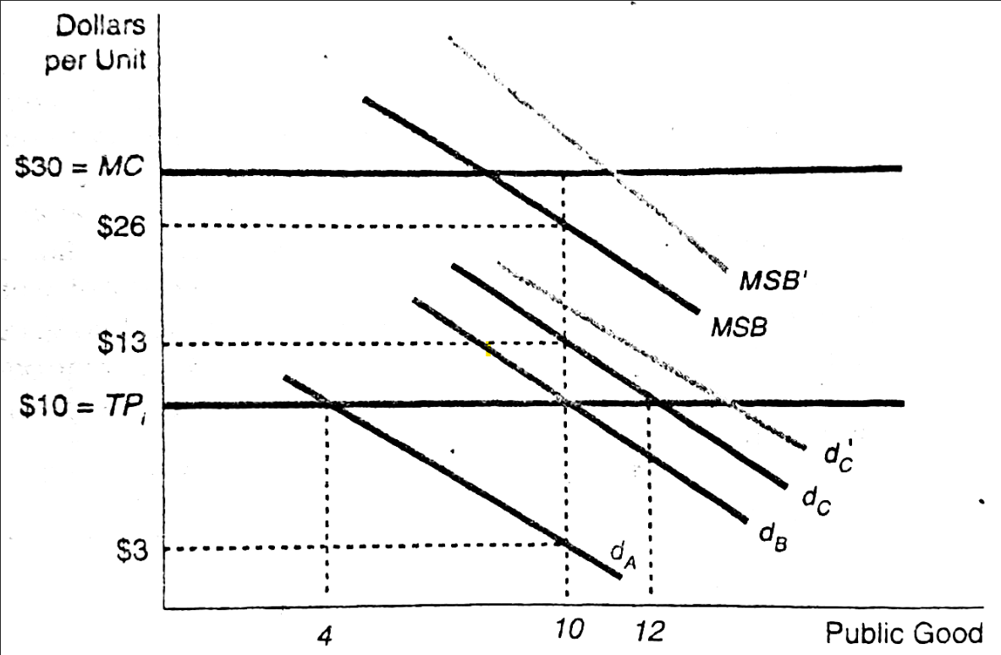
Majority Voting Does Not Ensure Efficiency
For public goods the efficient level of output is the point at which the vertically summed MB equals the MC. The individual MBs for taxpayers A, B & C at 10 units of outputs are $3, $10 & $13; so the combined MB is $26. But the MC for 10th unit is $30. So the majority voting produces too large an output.
If C’s dd were dc’ instead of dc, the summed MB would be MSB’ and the eqm level of output would be lower than efficient level.

Slide 16
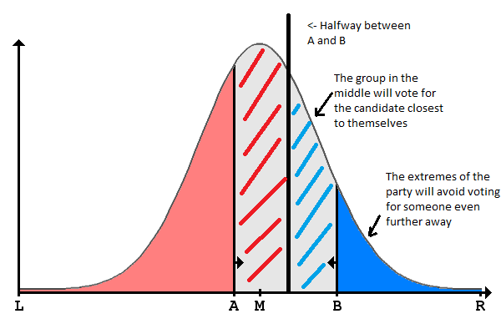
Median Voter Theorem

Slide 17
Relation Between Majority Voting & Median Voter Theorem
Majority voting is a procedure in which the alternative receiving more than half of the votes is chosen.
The median voter theorem is a theory stating that, when voters have single-peaked preferences over a one-dimensional issue, the alternative preferred by the median voter will be the majority-voting equilibrium.
Thus, majority voting is the mechanism, while the median voter theorem predicts the outcome of that mechanism under certain conditions.

Slide 18
Logrolling
A possible problem with simple majority voting is that it does not allow people to register how strongly they feel about the issues. Whether a particular voter just barely prefers A to B or has an enormous preference for A has no influence on the outcome. Logrolling systems allow people to trade votes and hence register how strongly they feel about various issues.
Suppose that voters Smith and Jones prefer not to have more missiles, but they don’t care all that much. Brown, on the other hand, definitely wants more missiles. With a logrolling system, Brown may be able to convince Jones to vote for more missiles if Brown promises to vote for a new road to go by Jones’s factory.

Slide 19
Contd.
Logrolling can lead to the passage of both efficient and inefficient policies that would not otherwise be enacted.
The process of logrolling is often defended as a means of protecting minority interests. There is also the possibility of overrepresentation of minority interests.
Logrolling among individual voters is not likely to occur when there are large numbers of voters. Logrolling is most likely to occur when a relatively small number of votes is required to achieve a majority.

Slide 20
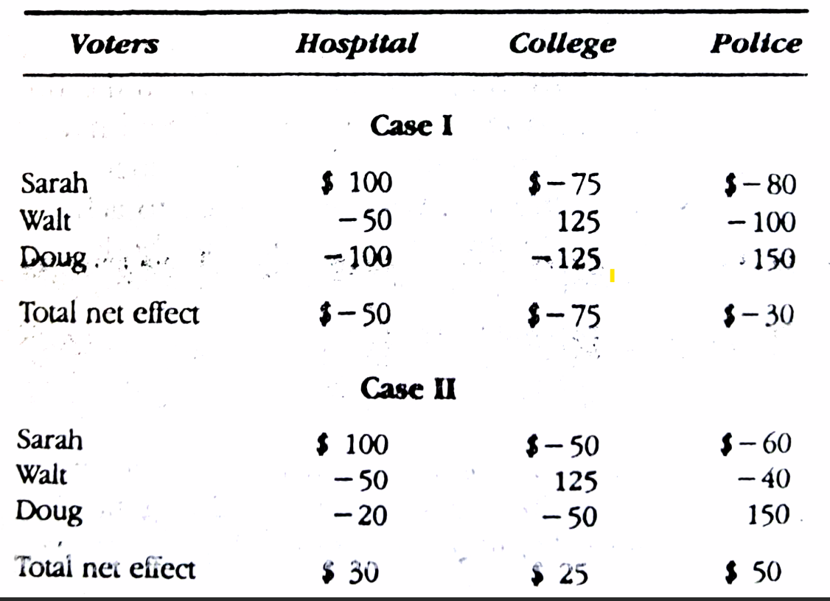

Slide 21
Arrow’s Impossibility Theorem R
We have shown that neither simple majority voting nor logrolling has entirely desirable properties. Many other voting schemes have also been considered, and they, too, are flawed.
An important question is whether any ethically acceptable method for translating individual preferences into collective preferences is free of difficulties. It depends on what you mean by “ethically acceptable.” Nobel laureate Kenneth Arrow [1951] proposed that in a democratic society, a collective decision-making rule should satisfy the following criteria:

Slide 22
1. It can produce a decision whatever the configuration of voters’ preferences. Thus, for example, the procedure must not fall apart if some people have multipeaked preferences.
2. It must be able to rank all possible outcomes.
3. It must be responsive to individuals’ preferences. Specifically, if every individual prefers A to B, then society’s ranking must prefer A to B.
4. It must be consistent in the sense that if A is preferred to B and B is preferred to C, then A is preferred to C.
5. Society’s ranking of A and B must depend only on individuals’ rankings of A and B. Thus, the collective ranking of manned space travel and foreign aid does not depend on how individuals rank either of them relative to research on a cure for AIDS. This assumption is sometimes called the independence of irrelevant alternatives.
6. Dictatorship is ruled out. Social preferences must not reflect the preferences of only a single individual.

Slide 23
Taken together, these criteria seem quite reasonable. Basically, they say that society’s choice mechanism should be logical and respect individuals’ preferences. Unfortunately, the stunning conclusion of Arrow’s analysis is that in general it is impossible to find a rule that satisfies all these criteria. A democratic society cannot be expected to make consistent decisions.
This result, called Arrow’s Impossibility Theorem, thus casts doubt on the very ability of democracies to function. Naturally, the theorem has generated debate, much of which has focused on whether other sets of criteria might allow formation of a social decision-making rule. It turns out that if any of the six criteria is dropped, a decision-making rule that satisfies the other five can be constructed. But whether or not it is permissible to drop any of the criteria depends on one’s views of their ethical validity.

Slide 24
Participants in the Political Process B
Voters
Politicians
Bureaus and bureaucrats
Pressure groups and lobbies

